Slide 1
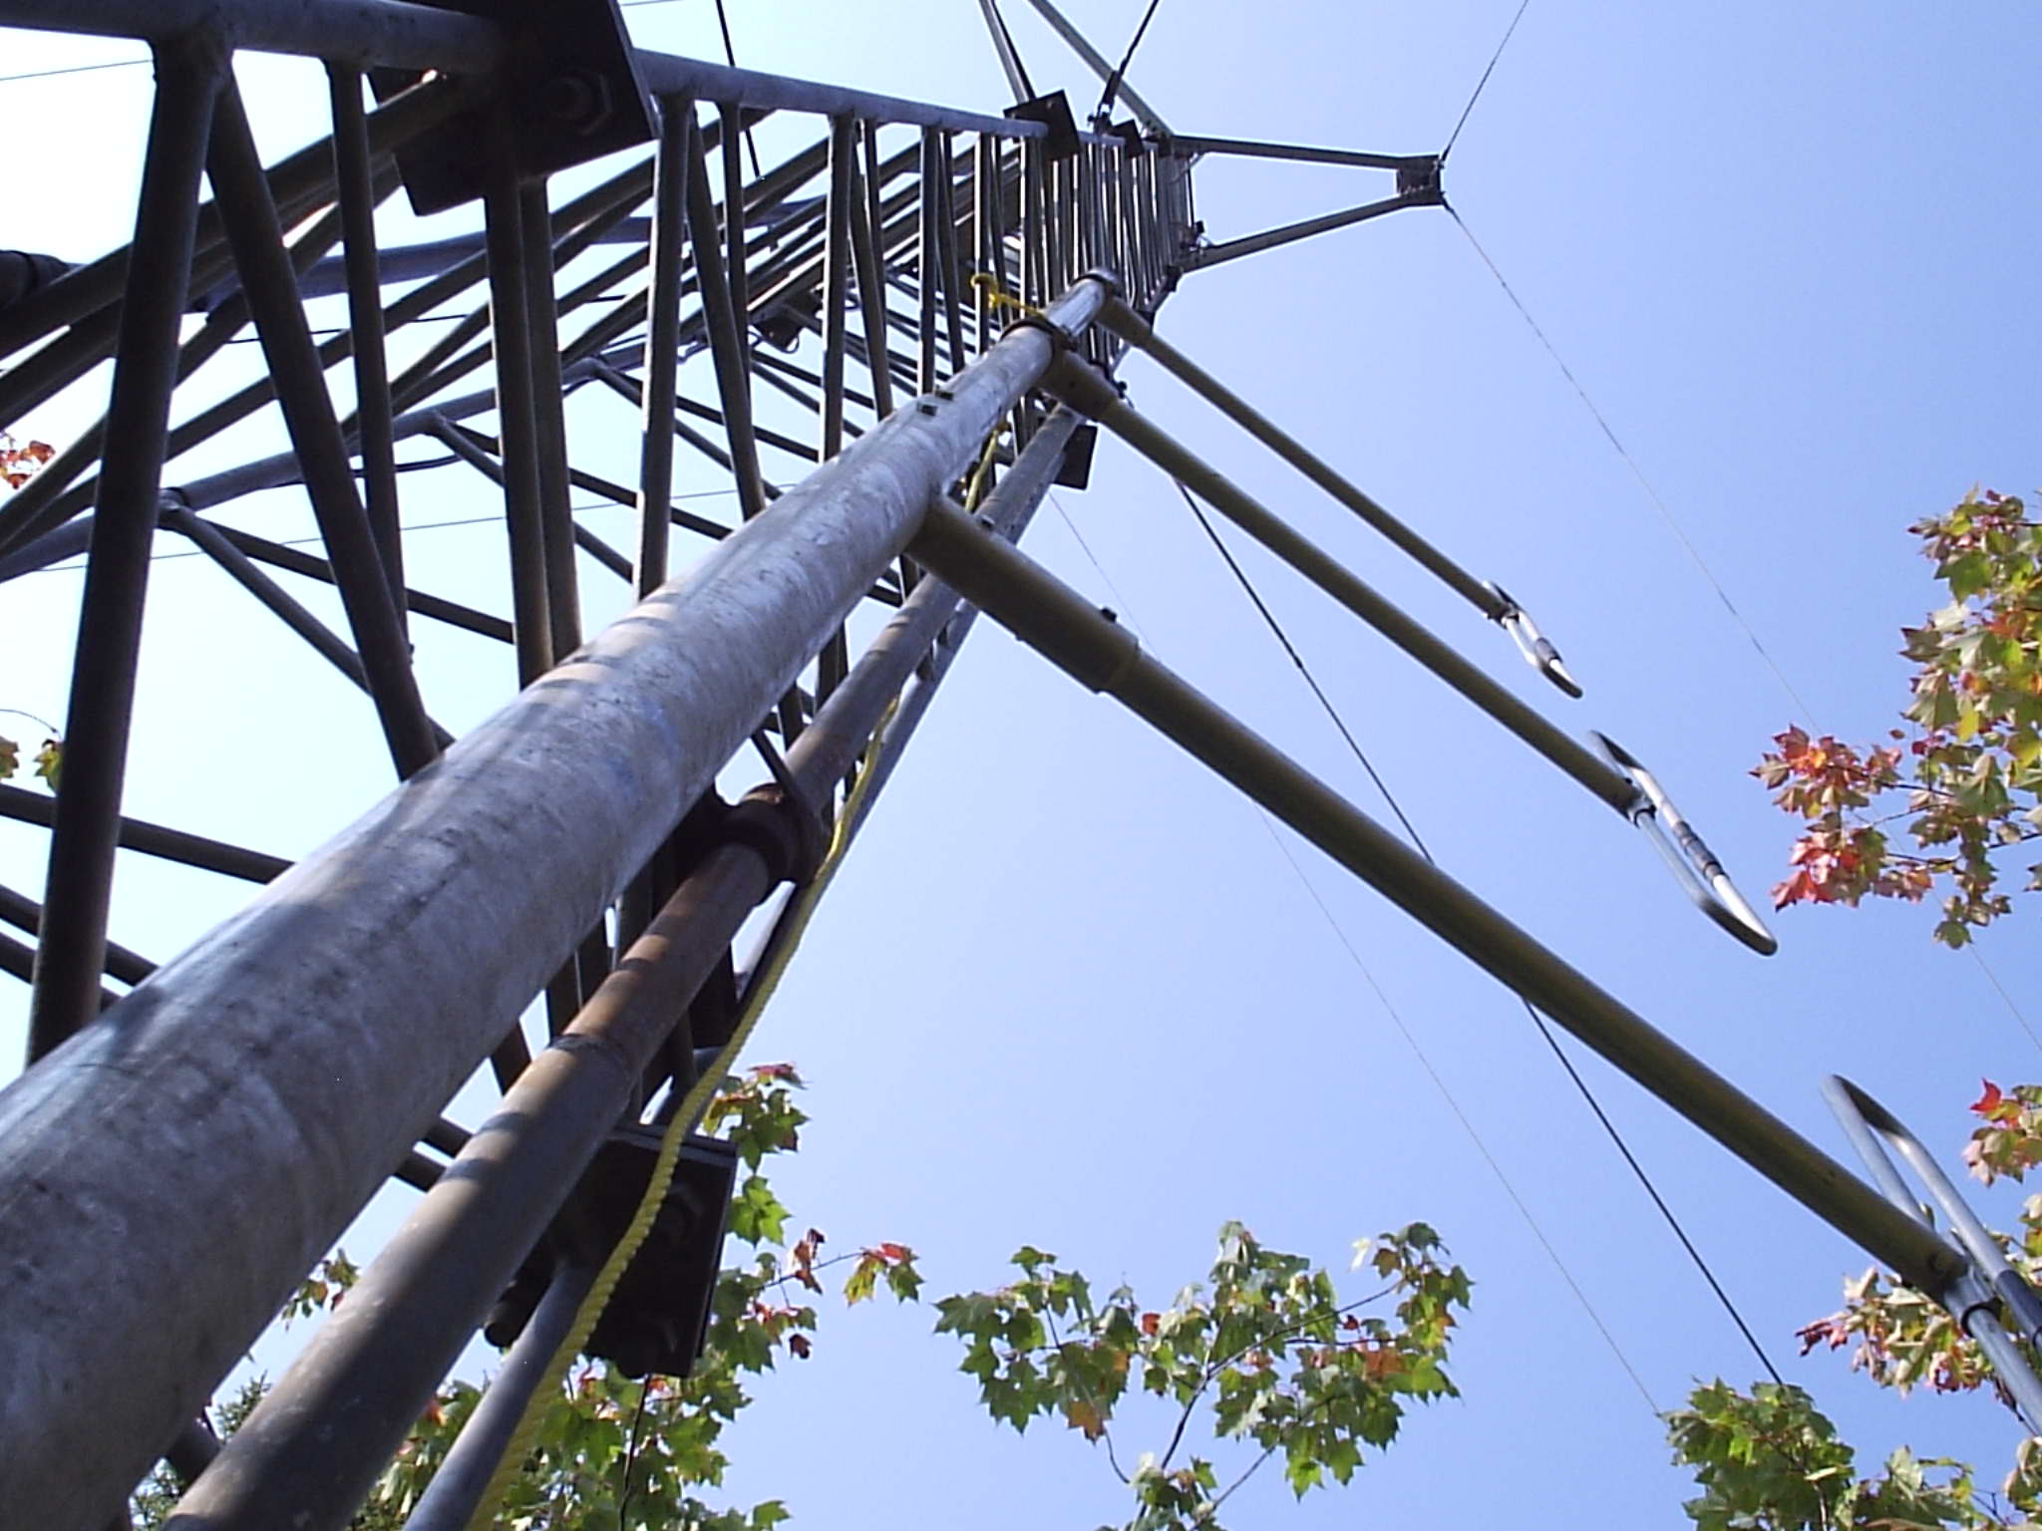
“When all else fails…”
A presentation to
Town of Atikokan staff
April 2018

Slide 2
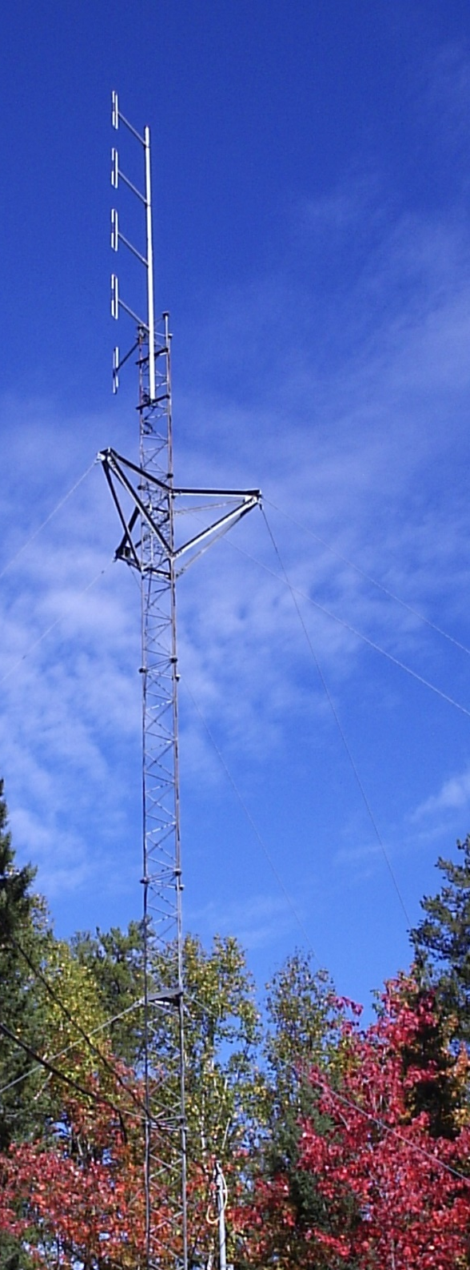
Agenda
What is amateur radio?
What we can do for you.
Local stations.
What we would like from you.
Also
CKAX
Communications Coordinator

Slide 3
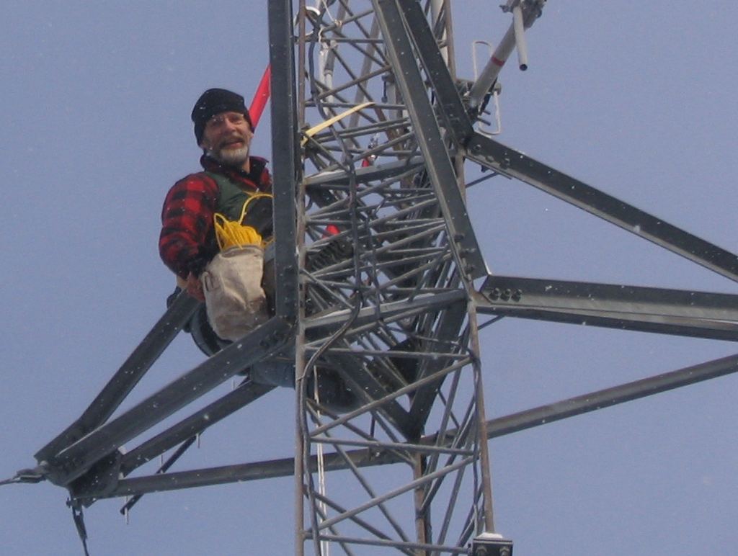
What is amateur Radio?
“When all else fails, there is amateur radio.”

Slide 4
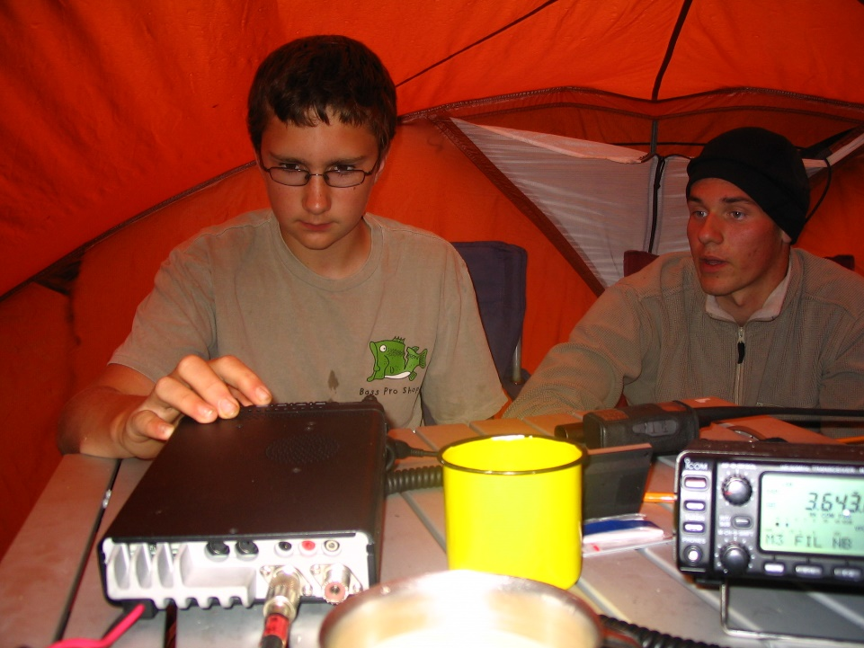
Who are “hams?”
We are licensed by Industry Canada.
  We have passed several exams.
  We are issued call signs. (VE3FYN)
Three main areas:
  Experimentation.
  Recreation.
  Emergency Communications

Slide 5
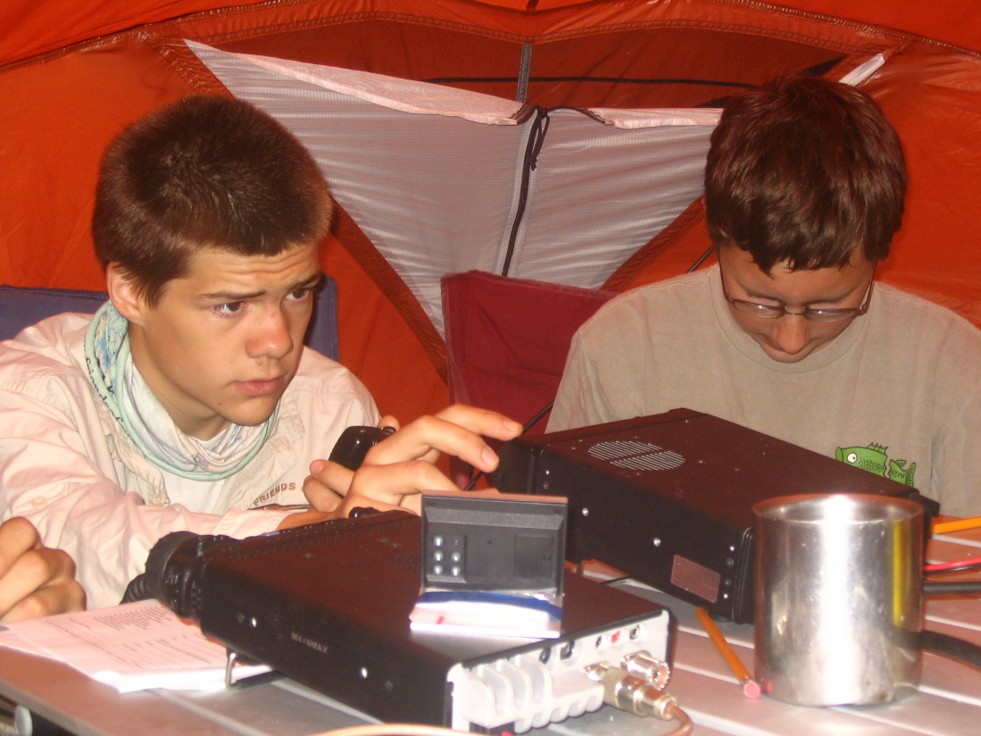
Local Amateurs
Vic Prokopchuk, VE3AKX
Geoff & Gwen Mayne, VE3SYR and VE3SYX
Erik Larson, VE3ENL
Jason Johnson, VE3PEJ
Paul Johnson, VA3JSV
Carol Gosselin, VE3COU
Jessic Bjorkman, VA3DSJ
Chris Ladouceur, VA3UOD

Slide 6
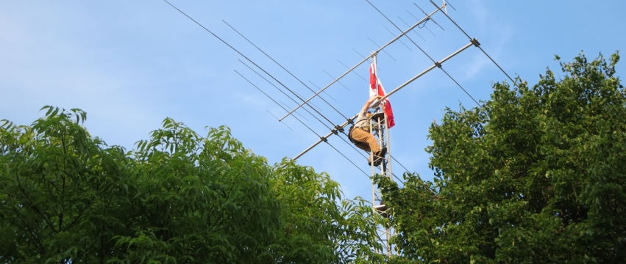
What do we do?
Radio communications...
  over a variety of frequencies;
  using voice, Morse Code, digital modes, computers;
  to send voice, text, pictures, video, e-mail;
  line-of-sight, via repeaters, bounced off satellites or planets, assisted by the Internet, reflected off the ionosphere;
Notes:
While, for instance, the Fire Department gets two or three frequencies on the same band, we get many chunks of the entire radio spectrum, and those different “bands” have different qualities.

Slide 7
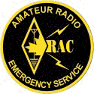
What is ARES?
ARES, the Amateur Radio Emergency Service.
  We provide emergency communications
  during disasters.
  We are recognized by Emergency Measures Ontario.
  We are recognized in the Atikokan Emergency Plan.
Our goal is to meet the municipal
EOC’s communications needs
when all else fails.
Notes:
Amateur Radio gets a significant share of the spectrum for free, with the understanding that we will provide emergency communications when needed.

Slide 8
When will you need us?
Only when all commercial communications fail.
Our data speeds are very slow. (150 – 1200 baud)
Some bands rely on ionospheric weather.
  Propagation changes hourly, daily, annually…
The truth is,
if any commercial communications exists, it will do a better job than we can.
Notes:
We can serve a public service function:
Xmas parade in Thunder Bay
Pumpkin Patrol in Dryden
RCMP Ride in Atikokan

Slide 9
This is not as unlikely as you might think…
There are few providers.
They depend on network integrity.
They share infrastructure.
Even cellular must reach beyond town to work.
Most have roughly eight hours of backup power.
Notes:
Sioux Narrows lost power for two days last summer. All phone communications was down after eight hours.

Slide 10
Why are we so effective?
We are a distributed system.
We do not depend on a physical network.
We have many overlapping technologies.
We can operate on many bands, each of which has different qualities.
We’re obsessed.

Slide 11
What comms will be needed
Coordination with neighbouring communities.
  Evacuations
  Equipment
Communication with provincial EOC.
Humanitarian traffic.
Comms between a scene and the EOC.

Slide 12
What we can do for you

Slide 13
Our Goal
Provide voice and data communications to:
  NWO communities,
  Toronto EOC,
  Other stations as needed.
Provide e-mail messaging to amateur stations or any Internet-connected station.
Provide text-type messaging in the region.
Provide GPS position information.

Slide 14
WinLink
Dynamic e-mail interface.
  Uses Internet where available.
  Uses HF radio where not available.
  Resistant to propagation issues.
Can send to any WinLink amateur station, or any working Internet address.
Not currently at Town Hall.
300 baud.
Notes:
This is available at the airport station.

Slide 15
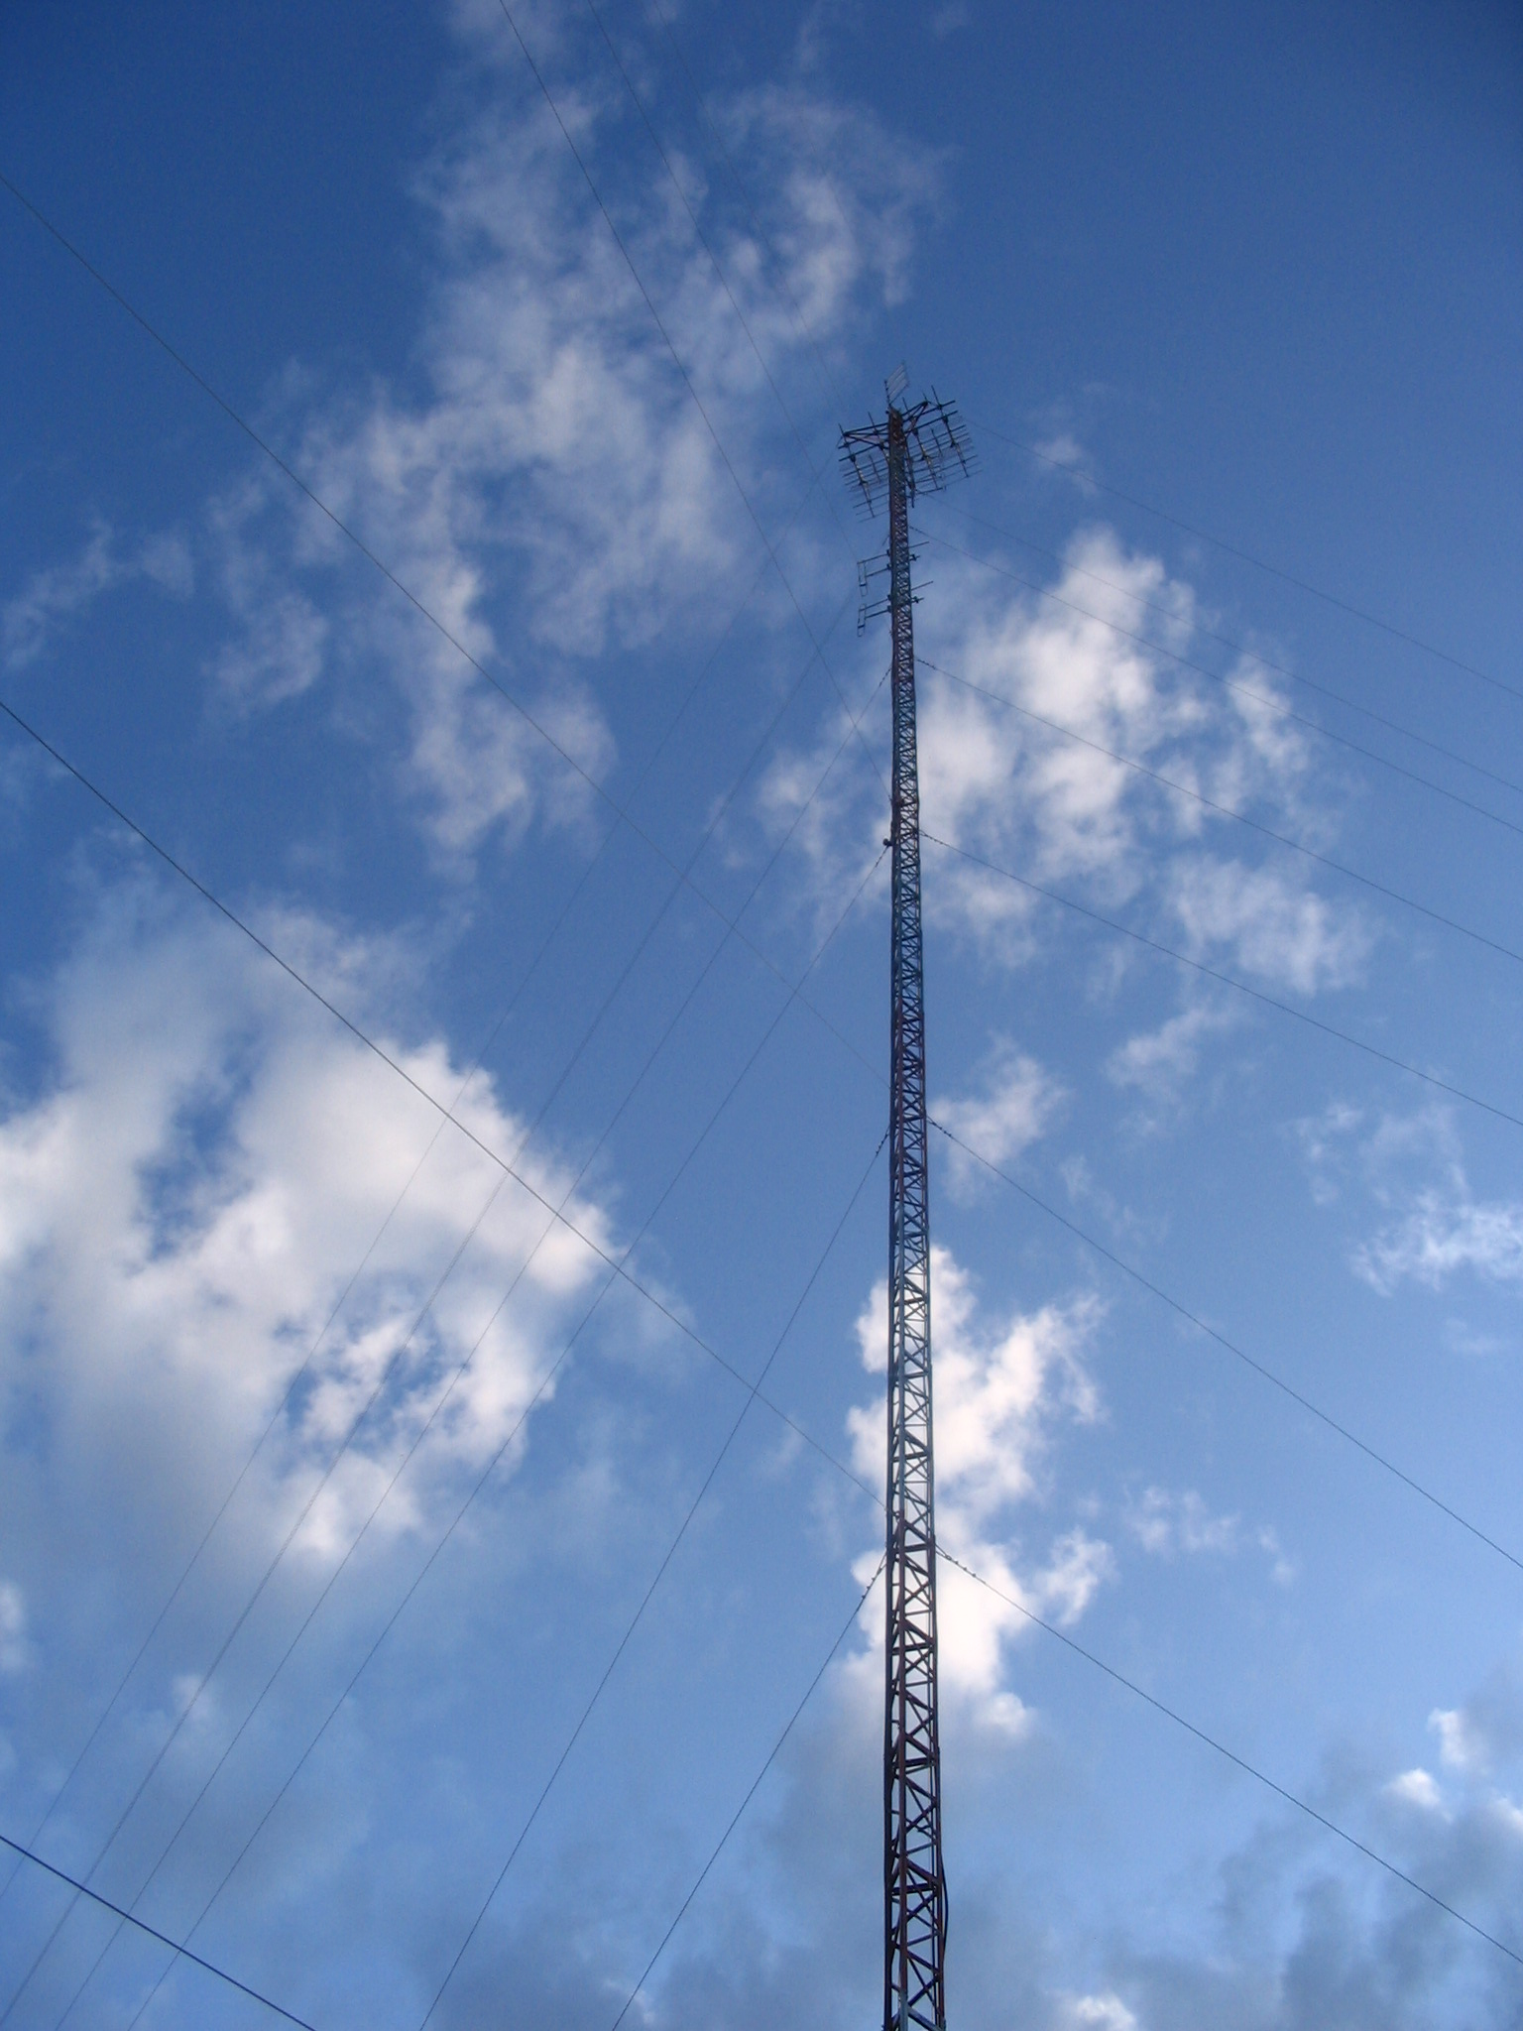
Linked Repeaters
(Pinetree Intertie)
Regional voice communications.
All links via radio (except Atikokan)
Constantly monitored.
Battery & generator backup.
Fixed network.
We are developing a VHF link to Dryden.
Notes:
We may ask for a letter of support from the Town, as we will require space at OPG, or a tower west of Atikokan that we currently occupy. This may play a role in emcomm, but honestly it is not as robust as other technologies. Any one tower going offline compromises the whole system.

Slide 16
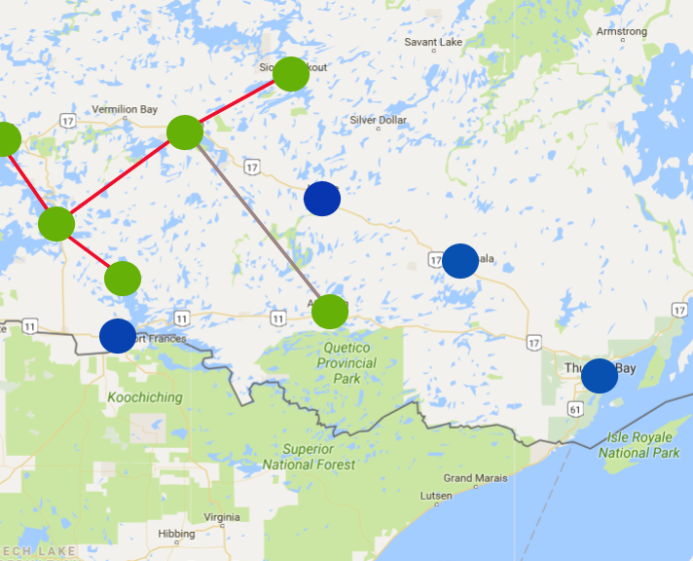

Pinetree Intertie

Slide 17
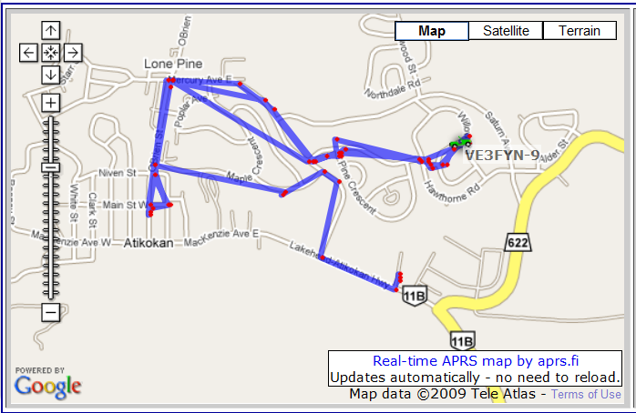
APRS
Interfaces GPS with radio and the Internet.
Flexible network.
Allows real-time tracking of stations.
Weather stations.
Allows text-messaging.
Can be re-configured
for e-mail.
1200 baud.

Slide 18
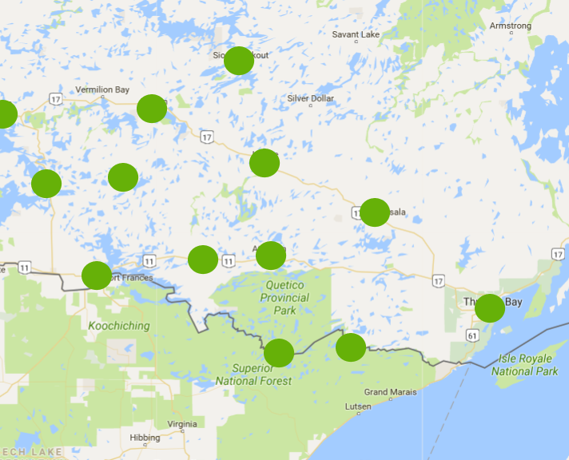
APRS Digipeaters

Slide 19
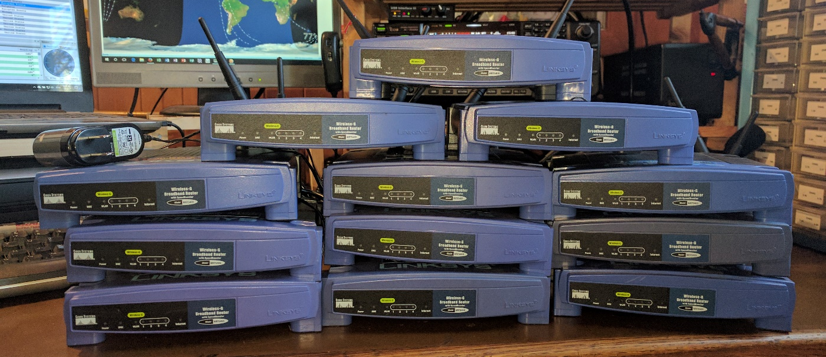
Broadband Hamnet
High-speed data using routers over distance.
Flexible MESH network.
Can be used to remotely control stations.
Currently under development.

Slide 20
Local stations
The ones on Town property, anyway

Slide 21
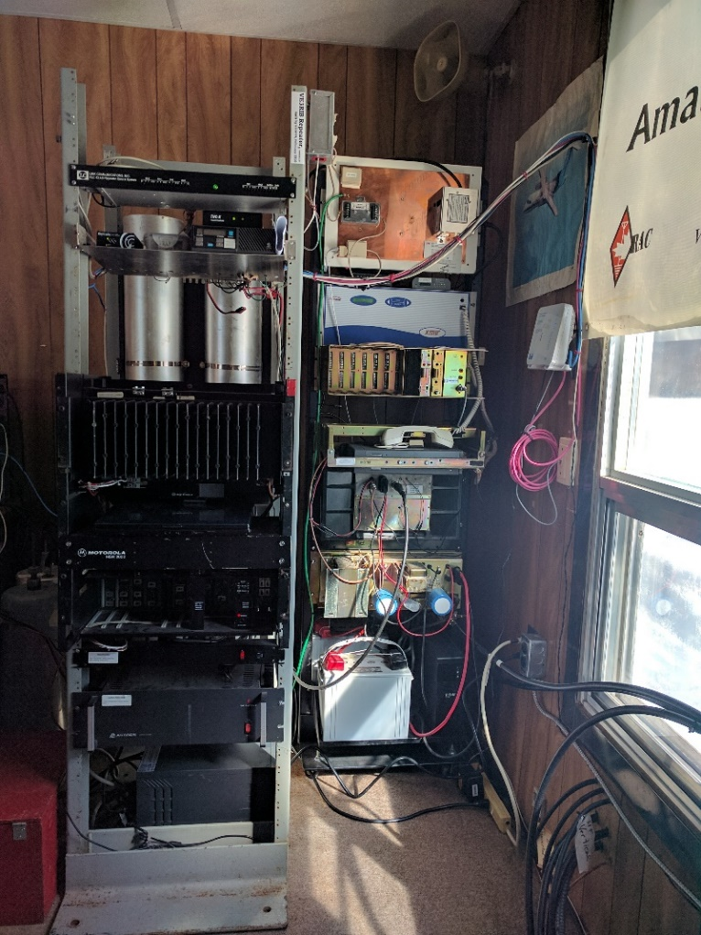
VE3RIB repeater (airport)
VE3RIB is the Atikokan repeater.
  Pinetree Intertie via Internet.
    RF link under development.
  APRS.
  Battery and generator backup.

Slide 22
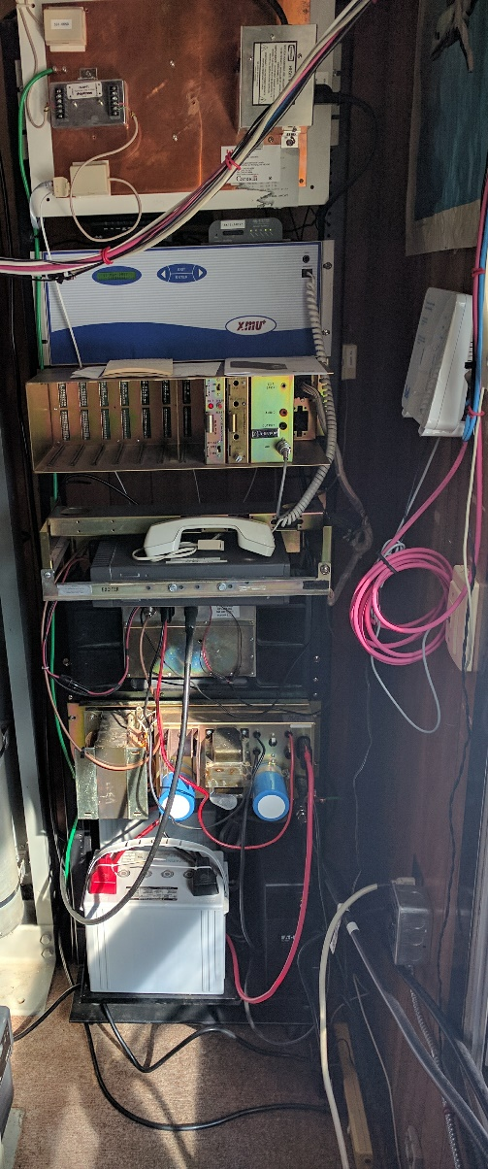
Weatheradio (airport)
Equipment supplied by Environment Canada.
Utilities supplied by Town.
Maintenance assistance by AARC.
Battery backup.
Generator backup
courtesy of AARC.

Slide 23
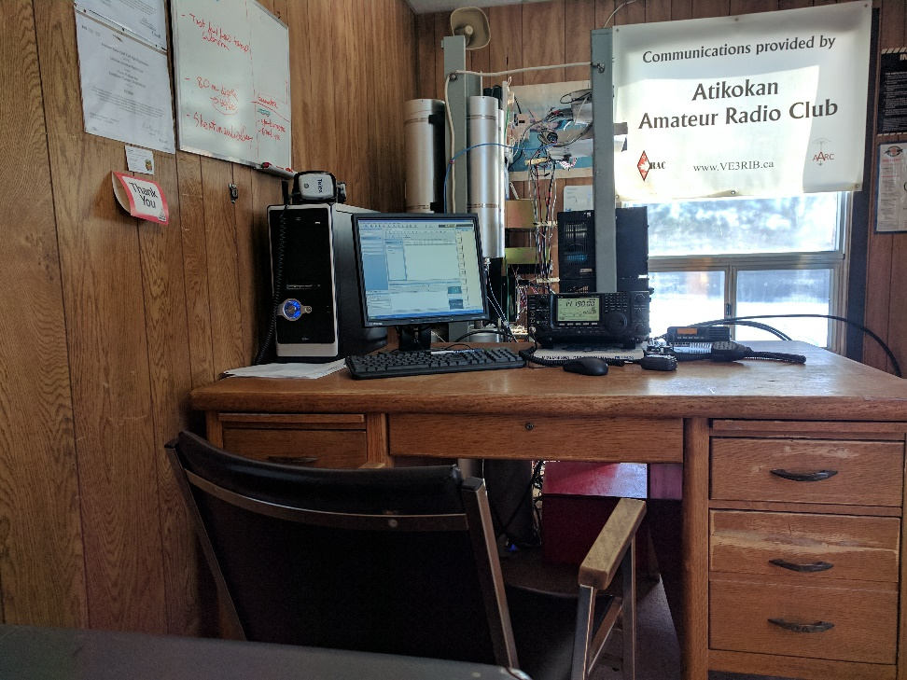
VE3YIB Club Station (airport)
HF voice.
VHF local and repeater access.
WinLink.
APRS.
Good antenna farm.
Battery and
generator backup.

Slide 24
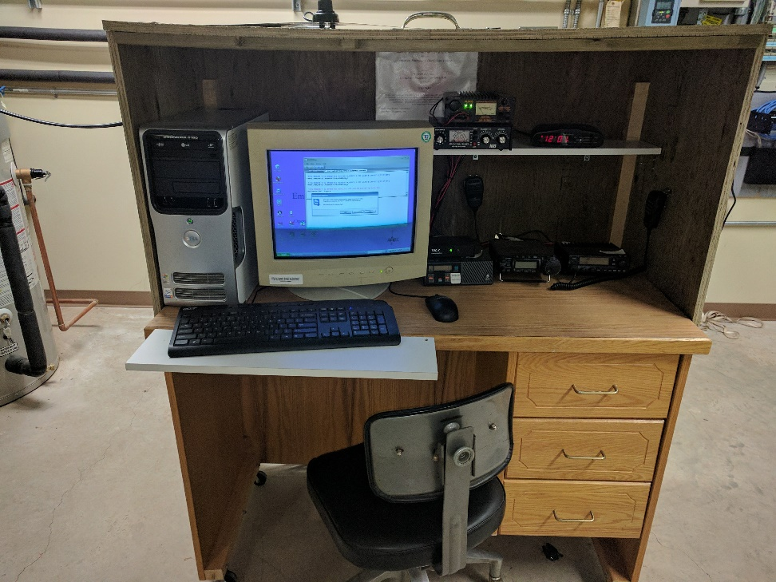
VA3EOA Station (Town Hall)
HF voice.
VHF local and repeater access.
APRS.
Poor antenna farm.
Battery and
generator backup.
Notes:
It would really be nice to get this out of the furnace room.

Slide 25
Current Projects
RF link to Dryden and Pinetree Intertie.
Broadband-Hamnet.
Development of a regional amateur radio emergency communications strategy.

Slide 26
Etcetera

Slide 27
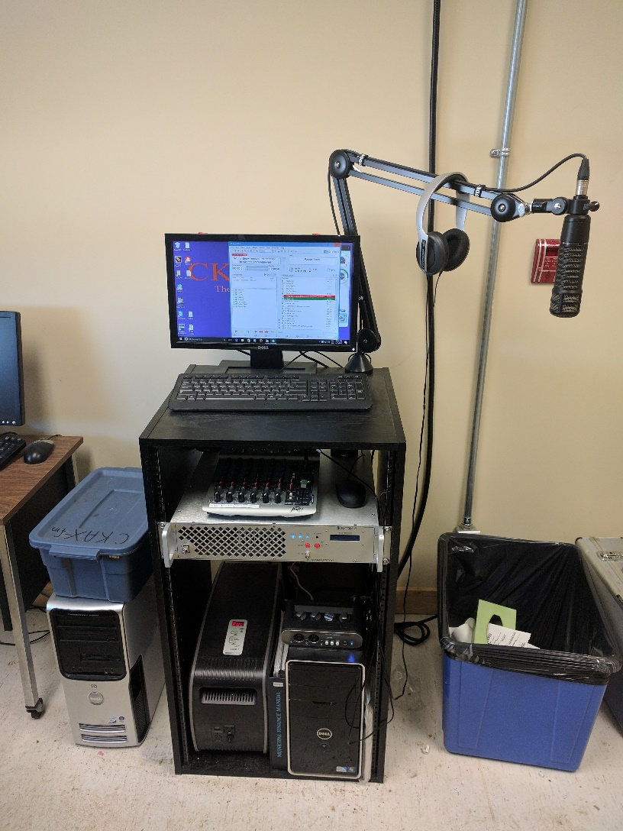
CKAX Station (Town Hall)
Broadcasts community information.
Paulson/McKinnon.
Purpose is to provide updates to public during disasters.
Battery and generator backup.
Notes:
Plans to move mic, mixer and computer next door.
There is potential to improve the content, e.g. boil water advisories.

Slide 28
Communications Coordinator
(B) Clarification of telephone system at municipal office.
  Dedicated phone lines?
(E) Cheap portable radios for emergencies.

Slide 29
And finally…

Slide 30
Our Wish List
Possible support letter to OPG.
Continued use of airport building.
Funds for WinLink interface at Town Hall.
Relocate Town Hall amateur station.
Relocate CKAX studio.

Slide 31
What we can provide for this
Local, regional and provincial emergency communications independent of any infrastructure, in many modes.
Documentation of communications traffic during emergencies.

Slide 32
End

